Slide 1
Information Processing and Retrieval
Project – Keyword Extraction
Group 22

Slide 2
First Part

Slide 3
Exercise 1 – Simple TFIDF Approach
Document
Google is acquiring data science community Kaggle.
Sources tell us that Google is acquiring Kaggle, a platform that hosts data science and machine learning competitions. Details about the transaction remain somewhat vague, but given that Google is hosting its Cloud Next conference in San Francisco this week, the official announcement could come as early as tomorrow. Reached by phone, Kaggle co-founder CEO Anthony Goldbloom declined to deny that the acquisition is happening. Google itself declined 'to comment on rumors'. Kaggle, which has about half a million data scientists on its platform, was founded by Goldbloom and Ben Hamner in 2010. The service got an early start and even though it has a few competitors like DrivenData, TopCoder and HackerRank, it has managed to stay well ahead of them by focusing on its specific niche. The service is basically the de facto home for running data science and machine learning competitions. With Kaggle, Google is buying one of the largest and most active communities for data scientists - and with that, it will get increased mindshare in this community, too (though it already has plenty of that thanks to Tensorflow and other projects). Kaggle has a bit of a history with Google, too, but that's pretty recent. Earlier this month, Google and Kaggle teamed up to host a $100,000 machine learning competition around classifying YouTube videos. That competition had some deep integrations with the Google Cloud Platform, too. Our understanding is that Google will keep the service running - likely under its current name. While the acquisition is probably more about Kaggle's community than technology, Kaggle did build some interesting tools for hosting its competition and 'kernels', too. On Kaggle, kernels are basically the source code for analyzing data sets and developers can share this code on the platform (the company previously called them 'scripts'). Like similar competition-centric sites, Kaggle also runs a job board, too. It's unclear what Google will do with that part of the service. According to Crunchbase, Kaggle raised $12.5 million (though PitchBook says it's $12.75) since its launch in 2010. Investors in Kaggle include Index Ventures, SV Angel, Max Levchin, Naval Ravikant, Google chief economist Hal Varian, Khosla Ventures and Yuri Milner.
Notes:
2017

Slide 4
Exercise 1 – Simple TFIDF Approach
Preprocessing consisted of lowercasing, removing stopwords, punctuation and numbers;
N-grams obtained using CountVectorizer, which also returns the TF.
Computed IDF for the document plus all files in the 20NewsGroup dataset.
For this document, results didn’t change if we weighted the TF-IDF value by the candidate’s length.

Slide 5
Exercise 1 – Feedback
Problems:
Preprocessing before generating n-grams.
So we changed:
First, generate n-grams. Then, remove candidates which contain numbers, punctuation, or stopwords in the first or last word.

Slide 6
Exercise 2 – Evaluation
Dataset: DUC-2001, 308 files.
Applied the previous approach to each one of the files in the dataset:
Preprocessed the whole dataset.
IDF computed once for the whole dataset.
Compared results with the Golden set using the following metrics:
Precision, Recal, F1, P@5, MAP

Slide 7

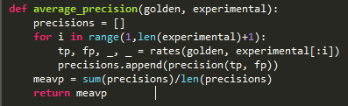
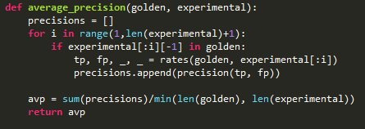
Exercise 2 – Feedback
Problems:
MAP
We were considering all the keyphrases instead of only the relevant ones.

Slide 8
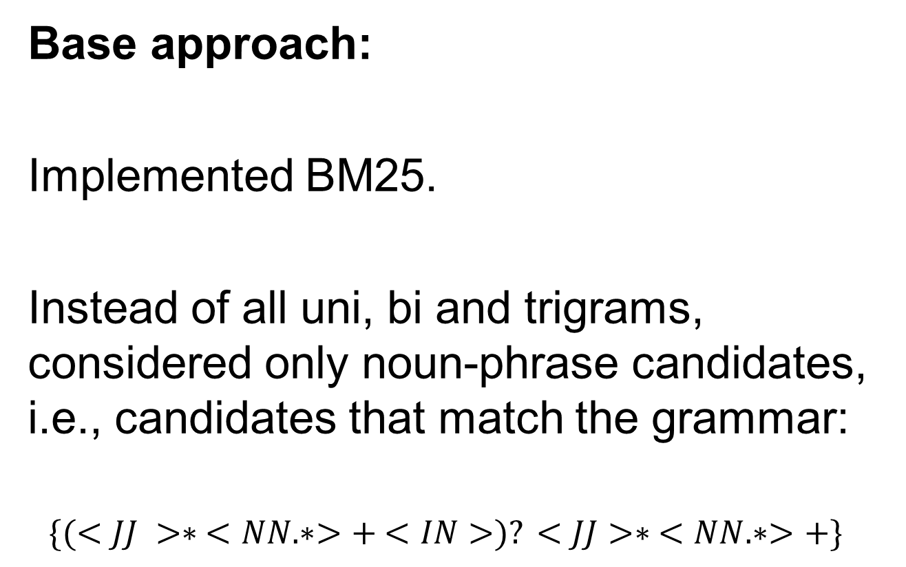
Exercise 3 – BM25 and Candidate Selection
Base approach:
Implemented BM25.
Instead of all uni, bi and trigrams, considered only noun-phrase candidates, i.e., candidates that match the grammar:
$$\{(<JJ >∗ <NN.∗>+ <IN>)? <JJ>∗ <NN.∗>+\}$$

Slide 9
Exercise 3 – BM25 and Candidate Selection
Other approaches:
Combining the BM25 score with the length of the candidate.
We tried multiple linear combinations for this, none of which presented better results than what we previously got.

Slide 10
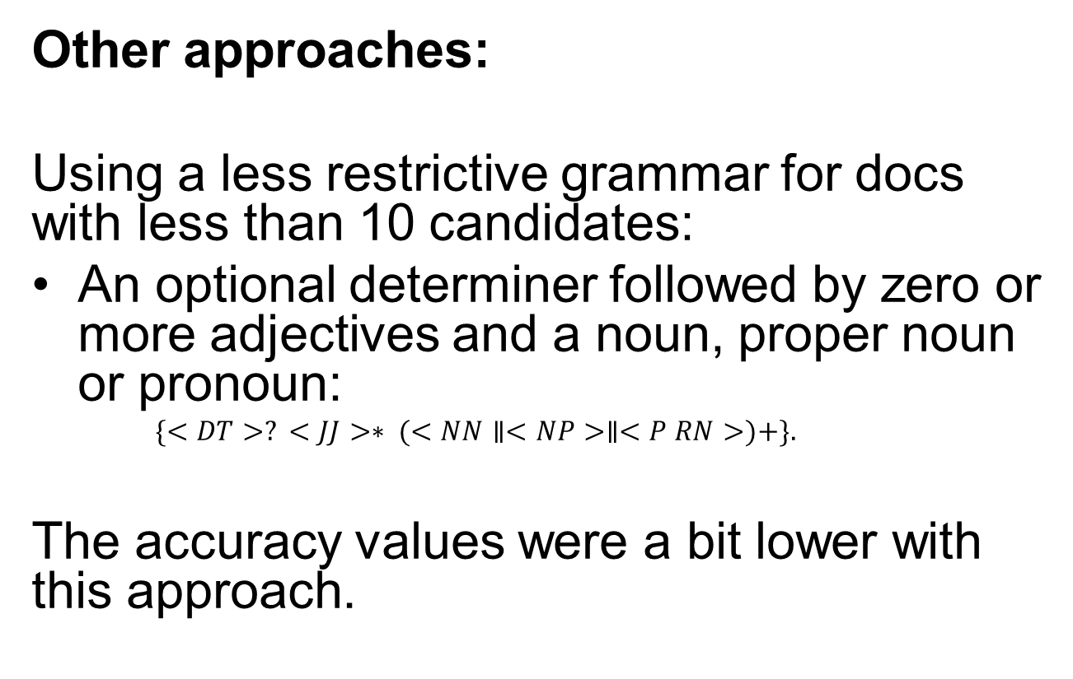
Exercise 3 – BM25 and Candidate Selection
Other approaches:
Using a less restrictive grammar for docs with less than 10 candidates:
An optional determiner followed by zero or more adjectives and a noun, proper noun or pronoun:
$$\{<DT>? <JJ>∗ (<NN∥<NP>∥<P RN>)+\}.$$
The accuracy values were a bit lower with this approach.

Slide 11
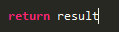
Exercise 3 – Feedback
Problems:
Candidate Extraction
Our function was returning an array of candidates, but with duplicates.

Slide 12
Exercise 4 – Supervised Approach
Manually split the dataset:
Prepossecing the same way as in the previous exercises.
TRAIN (90%)
TEST (10%)

Slide 13
Exercise 4 – Supervised Approach
We used the Perceptron algorithm.
Features : TFIDF score, number of words, position in document.
Training:
10000 epochs and a learning rate of 0.01

Slide 14
Exercise 4 – Feedback
Problems:
Not making predictions based on the probabilities returned by the classifier.
What we did was just get the class label that corresponded to the class with the highest probability.

Slide 15
Second Part

Slide 16
Exercise 1 – Simple PR approach
Preprocessed the document by removing stopwords and lowercasing.
Split into sentences (using punkt tokenizer, pre-trained model that avoids problems such as Mr. John, Ph.D, sentences starting with lowercase, etc…)
CountVectorizer to extract ngrams – strips punctuation.
Used NetworkX package. Unweighted graph:
Damping factor of 85% (d = 15%);
Nodes: candidates;
Edges: represent co-occurence in the same sentence.

Slide 17
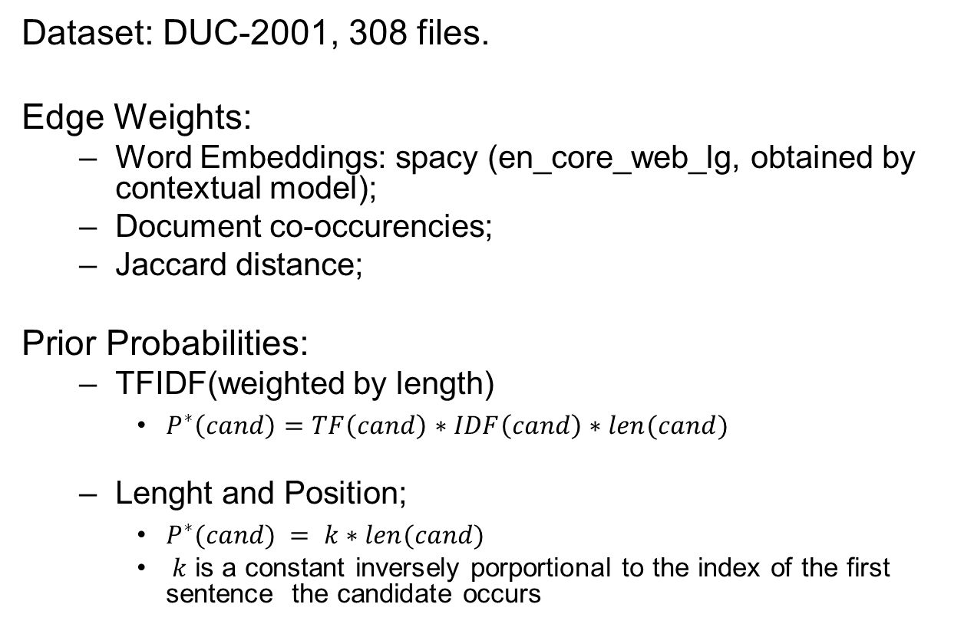
Exercise 2 – Improve and Evaluate
Dataset: DUC-2001, 308 files.
Edge Weights:
Word Embeddings: spacy (en_core_web_lg, obtained by contextual model);
Document co-occurencies;
Jaccard distance;
Prior Probabilities:
TFIDF(weighted by length)
$P^{∗}\left(cand\right)=TF\left(cand\right)∗IDF\left(cand\right)∗len(cand)$
Lenght and Position;
$P^{∗}(cand) = k∗len(cand)$
$k$ is a constant inversely porportional to the index of the first sentence the candidate occurs

Slide 18
Exercise 3 – Rank Aggregation
Features:
Page rank scores for P=TFIDF, W=OC;
Weighted TFIDF;
Unweighted TFIDF;
BM25;
Position in the document;
Tested for multiple combinations.

Slide 19
Exercise 3 – Rank Aggregation
When testing for the features used in the supervised approach, the results were better for this one.
Probably because the data on the supervised exercise wasn’t handled correctly, as the classes were very imbalanced.

Slide 20
Exercise 4 – Pratical Aplication
Fetched documents from RSS feed.
Scrapper can get the actual news text, but the files were way too large so we used only the descriptions and titles. The python code will generate a JSON file containing all the documents and its keyphrases.
Model used:
Reciprocal Rank Fusion;
Features: PRscore, Unweighted TFIDF, Position in document.
PR: Weights based on embeddings. Prior probabilities based on candidate length and position.

Slide 21
